Slide 1
Fall Prevention and Management

Slide 2
Objectives:
Discuss role in preventing patient falls.
Implement appropriate interventions for fall risk patients.
Describe how to identify a fall risk patient.
Purpose:
To improve patient safety
To reduce the incidence of patient falls
To identify potential fall risk
To put into place fall prevention interventions

Slide 3
Definitions:
Fall: Sudden, uncontrolled, unintentional, non-purposeful, downward displacement of the body to the floor/ground or hitting another object like a chair or stair.
Near Fall: sudden loss of balance that does not result in a fall or other injury. This can include a person who slips, stumbles or trips but is able to gain control prior to falling. It also includes Medical Personnel that catch the person or assist the person to slide down their legs.

Slide 4
Fall Risk Screening:
Nurses complete the MORSE Fall Scale (MFS), a screening tool to calculate the patient’s potential risk of falling.
A score of 0-24 indicates low fall risk
A score of 25-44 indicates a moderate fall risk
A score equal or above 45 indicates high fall risk

Slide 5
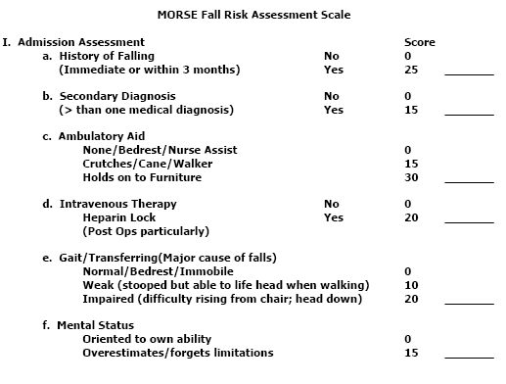
Risk Scale:

Slide 6
Assessed Low Fall Risk:
A patient assessed as Low Fall Risk (Universal Fall Precautions)
Score of 0-24
Orient to surroundings (bathroom, call light, etc.)
Place patient’s articles within easy reach
Lock wheelchair wheels (if applicable)
Place bed in low position and lock bed wheels
Use non-slip footwear when ambulating
Provide proper lighting (night or bathroom light)
Keep floor free of clutter
Clean up spills immediately

Slide 7
Assessed Moderate Fall Risk:
A patient assessed as Moderate Fall Risk (Universal Fall Precautions)
Score of 25-44
Use Applicable Universal Precautions + moderate interventions that are appropriate for the veteran
Check elimination needs every 2 hours
Keep wheelchairs in locked position
Ambulate with assistance
Check elimination needs every 2 hours
Use walker or assistive device (if ordered)

Slide 8
Assess High Fall Risk:
A patient assessed as High Fall Risk (Universal Fall Precautions)
Score of 45 or above
Patient will wear a yellow arm band
Patient will have a fall risk sign placed outside of the patient’s room or over/on their bed.
All high fall risk patients with medical issues or cognitive impairment where being unattended places them at risk must be escorted when leaving the unit.
All high-risk patients must have assistance when ambulating with a gait belt if indicated.

Slide 9
ABCS
Which Patients are at the highest risk for injury if they fall? (ABCS)
A (Age) – greater than 85
B (Bones) – History of falls with fractures, osteoporosis, prolonged steroid use, or metastatic bone cancer
C (Coagulation) – Anti-coagulation therapy (at risk for bleeding if fall occurs) or bleeding disorder
S (Surgery) Recent surgery during episode of care (especially recent lower limb amputation and major abdominal or thoracic surgery)

Slide 10
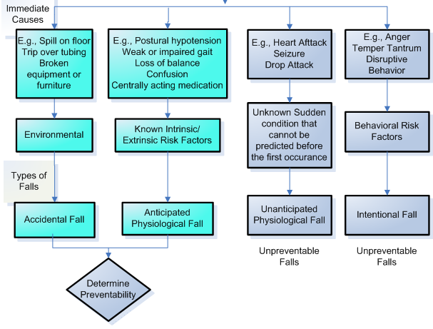
Examples of Immediate Causes Related to Types of Falls
Notes:
Spill on floor, trip over tubing, broken equipment or furniture relates to environment which causes accidental fall – determine preventability
Postural hypotension, weak or impaired gait, loss of balance, confusion, centrally acting medication relates to know intrinsic/extrinsic risk factors which causes anticipated physiological falls – determine preventability
Heart attach, seizure, drop attack relate to unknown sudden condition that cannot be predicted before the first occurrence which contributes to unanticipated physiological falls – unpreventable falls
Anger, temper tantrum, disruptive behavior contributes to behavioral risk factors which can lead to intentional falls – unpreventable falls

Slide 11
Policy:
Ensure a safe environment
Assess for risk of falls
Implement prevention strategies
Clinical management of the patient following a fall
High fall risk will be documented in the medical record for clinical warning.

Slide 12
Prevention and Management:
Complete the Morse Fall Risk Scale for the following:
All admitted patients
Upon admissions
Upon transfer
Upon change in patient condition
After a fall
At least every 30 days
Emergency/Urgent Care
Upon every visit

Slide 13
Prevention and Management:
Complete the Morse Fall Risk Scale for the following:
Outpatients
During primary care visit
All patients undergoing procedures are considered high risk for falls as a result of medications given
All patients receiving moderate sedation will have designated adult driver
All patients undergoing procedures are considered high risk for falls as a result of medications given
Annually in all other outpatient settings

Slide 14
Prevention and Management:
Complete the Morse Fall Risk Scale for the following:
Home Based Primary Care
Upon admission
After a fall
After a change in condition
Annually

Slide 15
Patient and Family Education:
Patient and Family Education
Evidence suggests that patient are more likely to understand their fall risk when engaged by their nurses in the risk assessment AND patients are more likely to follow the intervention plan when involved in developing it.
Educate patient and family about fall prevention in the home prior to discharge.

Slide 16
Responsibilities
Every employee providing direct/indirect patient care is responsible for:
1. Recognizing, correcting or minimizing potential
hazards that might contribute to patient falls.
2. Reporting uncorrectable hazards to the employee’s
immediate supervisor for appropriate action (e.g.,
electronic work order, phone call)
3. Recognizing patients identified as at risk for falls by
the yellow patient wrist band and signage.

Slide 17
Responsibilities:
It is up to all employees to observe for potential fall hazards in the workplace that could cause accidental falls.

Slide 18
When a Fall Occurs:
Make the situation safe
Preserve evidence and relevant information
Notify the provider or other appropriate staff member
The Nurse:
Assesses the patient, takes vital signs and blood glucose (if applicable)
Completes “EK-High Fall Risk” progress note (if applicable), which initiates a clinical posting.
Utilize post-fall huddles on your unit or work area to guide post-fall actions.
Enters an electronic note in CPRS titled, “EK-Post Fall/Near Fall” and enters a Patient Safety Report

Slide 19
Falls as Sentinel Events:
As of January 2021, The Joint Commission has updated their Sentinel Event Policy to include Fall Events!
A Sentinel Event is a patient safety event (not primarily related to the natural course of the patient’s illness or underlying condition) that reaches a patient and results in death, permanent harm, or severe temporary harm.
NEW Definition of Sentinel Fall Event in Joint Commission Policy:
  Sentinel Fall Event: Fall resulting in any of the following: any fracture; surgery, casting, or traction; required consult/management or comfort care for a neurological (for example, skull fracture, subdural or intracranial hemorrhage) or internal (for example, rib fracture, small liver laceration) injury; or a patient with coagulopathy who receives blood products as a result of the fall; death or permanent harm as a result of injuries sustained from the fall (not from physiologic events causing the fall).

Slide 20
Falls as Sentinel Events:
What does the addition of Fall Events to the Joint Commission Sentinel Event policy mean for us?
Fall Events that meet the new Joint Commission definition of a Sentinel Event will now follow the facility policy for reporting Sentinel Events – see Quality Manager for more information on this.
We will do an in-depth review of any fall that meets the new Joint Commission definition of a Sentinel Event – this is no change from our current practice, we regularly review all fall events!

